Slide 1
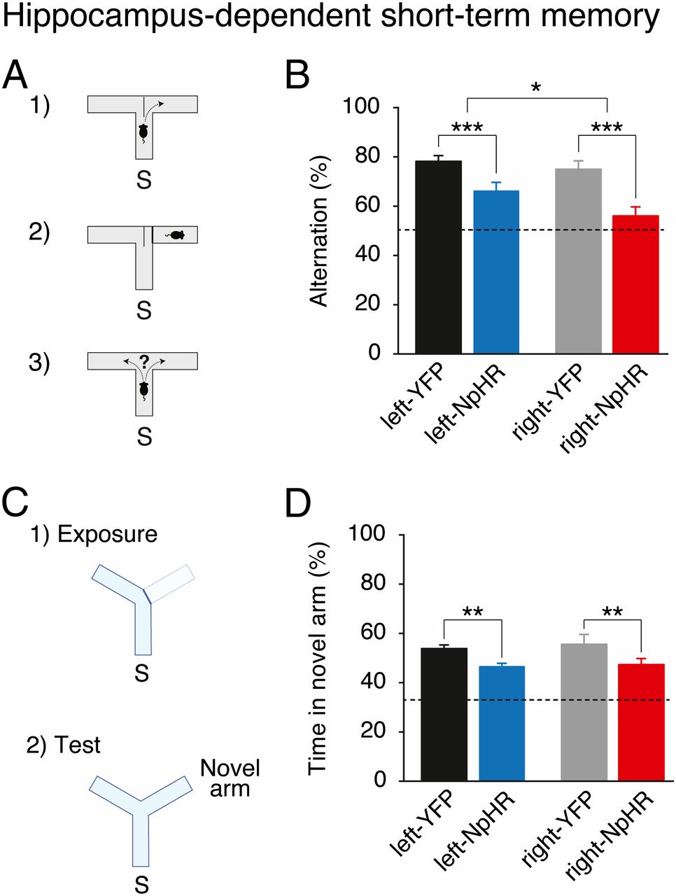

Hippocampus-dependent short-term memory requires the left and right CA3.
Olivia A. Shipton et al. PNAS 2014;111:42:15238-15243
©2014 by National Academy of Sciences
Notes:
Hippocampus-dependent short-term memory requires the left and right CA3. (A) Mice were tested on a spontaneous alternation task in a T-maze. S, start arm. (B) Light delivery during this task reduces spontaneous alternation of right-NpHR and left-NpHR mice compared with their respective YFP controls. (C) Mice were tested on a spatial novelty preference task in a Y-maze. (D) Light delivery during this task reduces preference for the novel arm in right-NpHR and left-NpHR mice compared with their respective YFP controls. Broken lines represent chance performance. Mean percentages ± SEM. *P < 0.05; **P < 0.01, ***P < 0.001.

